Slide 1
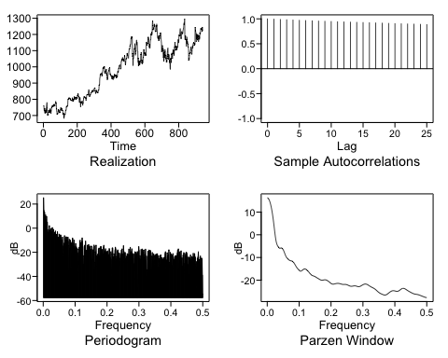
Google Closing Stock Price
Wandering in the time series realization and slowly damping ACF indicate the presence of at least one unit root.
Dickey Fuller also indicates the presence of a unit root.
adf.test(googl) ## Augmented Dickey-Fuller Test ## ## data: googl ## Dickey-Fuller = -2.8866,
Lag order = 9, p-value = 0.203

Slide 2
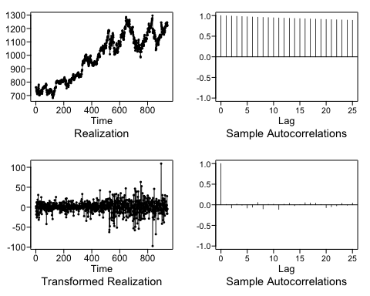
ARIMA
xd1 = artrans.wge(googl,phi.tr = 1)
aic5.wge(xd1)
## Five Smallest Values of aic
## p q aic ## 9 2 2 5.388026 ## 17 5 1 5.388246 ## 14 4 1 5.388461 ## 15 4 2 5.388531 ## 12 3 2 5.390017
amodel = est.arma.wge(xd1,p=2,q=2)
## Coefficients of Original polynomial: ## 0.0834 0.6371 ## ## Factor Roots Abs Recip System Freq ## 1-0.8410B 1.1891 0.8410 0.0000 ## 1+0.7576B -1.3200 0.7576 0.5000 df = data.frame(phi=amodel$phi,theta=amodel$theta,avar=amodel$avar, d = 1) df
## phi theta avar d ## 1 0.08343329 0.08353262 216.4585 1 ## 2 0.63708949 0.72309028 216.4585 1

Slide 3
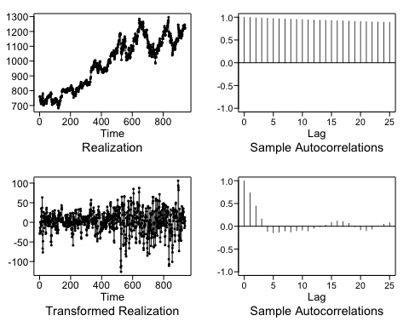
Seasonal
xs4 = artrans.wge(googl,phi.tr = c(0,0,0,1),plottr = TRUE)
## Five Smallest Values of aic
## p q aic ## 14 4 1 5.644851 ## 17 5 1 5.646045 ## 18 5 2 5.647035 ## 15 4 2 5.676557 ## 16 5 0 5.747056
smodel = est.arma.wge(xs4,p=4,q=1)
## ## Coefficients of Original polynomial: ## 0.0177 0.6172 -0.0317 -0.3615 ## ## Factor Roots Abs Recip System Freq ## 1-1.3580B+0.6171B^2 1.1002+-0.6402i 0.7856 0.0839 ## 1+1.3403B+0.5857B^2 -1.1441+-0.6311i 0.7653 0.4198 ## df = data.frame(phi=smodel$phi,theta=smodel$theta,avar=smodel$avar, d = 1) df
## phi theta avar d ## 1 0.01765811 -0.9972141 279.2362 1 ## 2 0.61721711 -0.9972141 279.2362 1 ## 3 -0.03173552 -0.9972141 279.2362 1 ## 4 -0.36148922 -0.9972141 279.2362 1

Slide 4
Signal Plus Noise
lm
z <- fortify.zoo(googl, name = "Date") x <- z$GOOGL.Close t = seq(1,length(x),1) df = data.frame(x = x, t= t) fit = lm(x~t, data = df) summary(fit)
## ## Call: ## lm(formula = x ~ t, data = df) ## ## Residuals: ## Min 1Q Median 3Q Max ## -168.45 -42.79 -10.56 41.65 200.68 ## ## Coefficients: ## Estimate Std. Error t value Pr(>|t|) ## (Intercept) 7.137e+02 4.152e+00 171.90 <2e-16 *** ## t 5.745e-01 7.628e-03 75.31 <2e-16 *** ## --- ## Signif. codes: 0 '***' 0.001 '**' 0.01 '*' 0.05 '.' 0.1 ' ' 1 ## ## Residual standard error: 63.66 on 940 degrees of freedom ## Multiple R-squared: 0.8578, Adjusted R-squared: 0.8577 ## F-statistic: 5672 on 1 and 940 DF, p-value: < 2.2e-16
Chochrane-Orcutt
cfit = cochrane.orcutt(fit) summary(cfit)
## Call: ## lm(formula = x ~ t, data = df) ## ## Estimate Std. Error t value Pr(>|t|) ## (Intercept) 709.095757 37.388436 18.966 < 2.2e-16 *** ## t 0.577563 0.064928 8.895 < 2.2e-16 *** ## --- ## Signif. codes: 0 '***' 0.001 '**' 0.01 '*' 0.05 '.' 0.1 ' ' 1

Slide 5
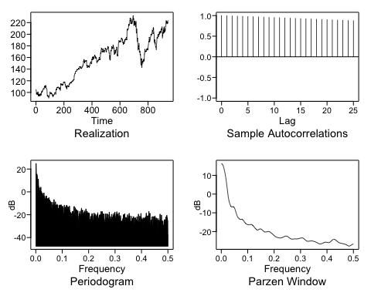
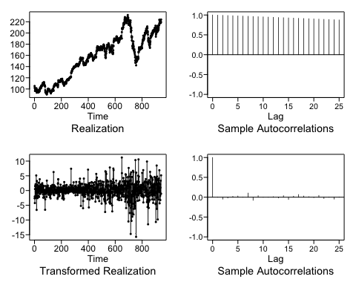
AAPL Analysis
Difference
Final Model is (1-B)X_{t} = a_{t}
Variance is sd(differenced_data)^2 =6.620517

Slide 6
Take Away
The derivation of Cochrane-Orcutt was difficult to follow.
How do we estimate parameters for signal plus noise models?

